Slide 1
Introduction to Software Engineering
CSSE3113

Slide 2
Description & Objective
Describe the field of Software Engineering
Give an overview of Software Engineering Activities
Give knowledge of software engineering concepts, principles and techniques
Enable students to apply the learnt concepts to develop software

Slide 3

Guidelines
The course outline is tentative
Evaluation will be based on all class discussions, handouts, recommended readings, slides etc.
Rote learning
Active participation
Announcements etc. will be made via Portal

Slide 4
Plagiarism
Cheating is not only unethical; it is also against the University rules and will not be tolerated. Any form of cheating in programming assignments, homework problems, quizzes, and exams will result in strict action. Plagiarism detection tools will be used to determine who has cheated in programming assignments.
All the parties involved will be awarded Zero in first instance. Repeat of the same offense will result in (F) grade.
USE PROPER REFERENCING IF ANY MATERIAL TAKEN FROM ANYWHERE
NO REFERENCE MEANS DECEPTION

Slide 5
Guidelines (Contd.)
Honor Code
Permitted Collaboration
Not Permitted Collaboration (i.e. Plagiarism)
Assignments
Copying solutions from others
Using work from past semesters
Studying other students’ solution
Quizzes and Exams
Looking at others’ exam
Not keeping your eyes on your examn quizzes 1st offense will result in award of -1, 2nd offense -2, 3rd -5 and 4th offense will result in cancellation of the quiz)

Slide 6
Guidelines (Contd.)
Honor Code (Contd.)
Not Permitted Collaboration (Contd.)
Penalty
Grade reduction
Referral to concerned authority in the University
F Grade
All of the above ☺
Other Offenses
Penalty
Same as above

Slide 7
Course Work
Quiz x 6 (Announced + Unannounced) – 15%
Assignment x 4 (VIVA/QUIZ) – 10%
Project Deliverable x 2 (VIVA) – 10%
Mid Term Exam – 20%
Final Exam – 40%
Class Participation* – 05%
ATTENDANCE+PUNCTUALITY+WRITTEN EXCERCISES+QA
DON’T ASSUME ,THERE WILL BE BEST OFF

Slide 8
What iS EXPECTED OF YOU
Analytical Skills
Punctuality
Perseverance
Dedication
Time-Devotion
Intelligence
Sincerity
ATTENDANCE WILL BE TAKEN AT START OF CLASS. NO REPEAT-CALLS
LATE PENALTY FOR SUBMISSIONS IS 25%/day
CELL PHONES & ALL OTHER DISTRACTIONS ARE HIGHLY DISCOURAGED AND MAY LEAD TO PENALTIES

Slide 9
Text Book
Shari Lawrence PFleeger and Joanne M. Atlee, Software Engineering Theory and Practice, 4th Edition (Selected Chapters Only)
Soft copy updated on portal
Roger Pressman, Software Engineering: A Practitioner’s Approach, 7th Edition (Selected Chapters Only)
Soft copy updated on portal

Slide 10
Course Outline
Course Introduction. Introduction to Software Engineering (SE)
Software Process Models
Managing a Project
Gathering and Specifying Requirements
Process and Project Metrics
Product Metrics
Designing a System
Quality Control and Quality Assurance
Estimation of Software Projects
Testing the Programs and System

Slide 11
Questions????
Welcome to the course! Lets start…

Slide 12
Computer Program
What is a computer program?
A representation of an algorithm?

Slide 13
Software
What is a Software?
A set of programs working for a single goal (solving a problem)?

Slide 14
What is Software?
“ Software is a set of instructions to acquire inputs and to manipulate them to produce the desired output in terms of functions and performance as determined by the user of the software. It also include a set of documents, such as the software manual , meant for users to understand the software system.”

Slide 15
Description of the Software
A software is described by its capabilities. The capabilities relate to the functions it executes, the features it provides and the facilities it offers.
Software written for Sales-order processing would have different functions to process different types of sales order from different market segments . The features for example , would be to handle multi-currency computing, updating product , sales and Tax status. The facilities could be printing of sales orders, email to customers and reports to the store department to dispatch the goods.

Slide 16
Examples of Programs or Software?
Calculate the average of three numbers
Find the minimum of three numbers
Count the number of red balls in a bag

Slide 17
Examples of Software or Programs?
Operating System?
Microsoft Office?
UCP Portal?

Slide 18
Software Engineering
“A systematic approach to the analysis, design, implementation and maintenance of software.”
(The Free On-Line Dictionary of Computing)
“ The systematic application of tools and techniques in the development of computer-based applications.”
(Sue Conger in The New Software Engineering)
“ Software Engineering is about designing and developing high-quality software.”
(Shari Lawrence Pfleeger in Software Engineering -- The Production of Quality Software)

Slide 19
What is Software Engineering?
Although hundreds of authors have developed personal definitions of software engineering, a definition proposed by Fritz Bauer[NAU69] provides a basis:
“[Software engineering is] the establishment and use of sound engineering principles in order to obtain economical software that is reliable and works efficiently on real machines.”
The IEEE [IEE93] has developed a more comprehensive definition when it states:
“Software Engineering: (1) The application of a systematic, disciplined, quantifiable approach to the development, operation, and maintenance of software; that is, the application of engineering to software. (2) The study of approaches as in (1).”

Slide 20
Software Engineering
The study of approaches as in
Application of a systematic, disciplined, quantifiable approach to the development, operation and maintenance of software; that is, the application of engineering to software.
(IEEE 93)

Slide 21
By “Systematic” we mean
Following a well-defined sequence of activities, - in which desired outputs (deliverables) are well-defined - by using well-defined inputs (i.e. documented syntax, semantics, context and other relevant properties of the input) - in a well-defined process (e.g. using organizational standards for interprocess communication, data formats, error handling etc.) - whose outputs are in turn used similarly as inputs in subsequent process(es), - until the final output is achieved, - and where the correctness of the output is verifiable. Note: The “inputs” and “outputs” most often refer to requirements, software specifications, the software itself, documentation, test inputs/outputs and similar software artifacts.

Slide 22
By “disciplined” we mean:
Each process is followed using organizational principles (e.g. who manages whom, who is responsible for what?),
Intermediate results are carefully documented, as well as final results,
Actions are traceable as to their causes, individuals involved, time of occurrence and circumstances.

Slide 23
By “quantifiable” we mean:
The size and extent of the required effort (size of output code, data, documentation, manpower, duration, budget for development, expected error rate and user support) are predictable within justifiable and acceptable bounds

Slide 24
What is Software Engineering?
Pressman’s view:
“ Software engineering is a layered technology”
(Figure 2.1)
Tools
Methods
Process
A quality Focus

Slide 25
Software Engineering
Solving Problems
Computers
Computing
How is a problem solved normally?

Slide 26
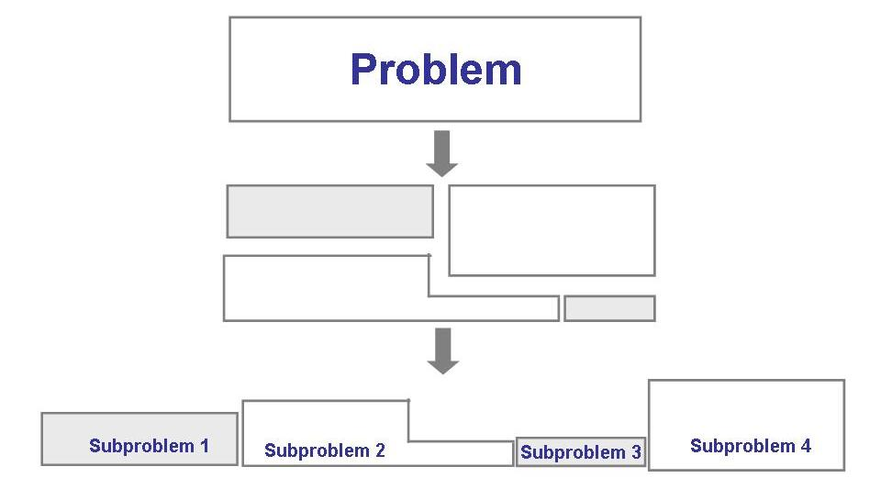
Solving Problems (continued)
Analysis

Slide 27
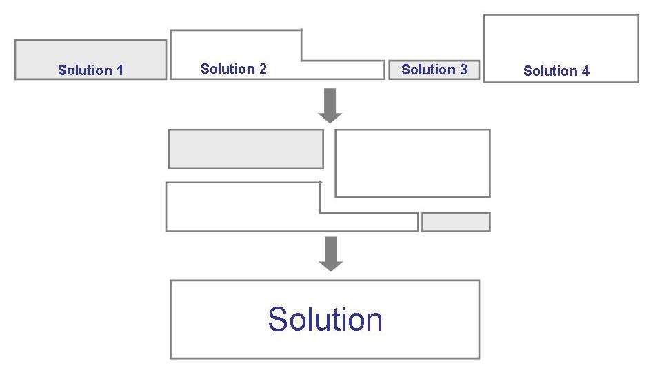
Solving Problems (continued)
Synthesis

Slide 28
Solving Problems (continued)
Method: refers to a formal process for accomplishing a goal that is typically independent of the tools used
Tool: an instrument or automated system for accomplishing something in a better way
Procedure: a combination of tools and techniques to produce a product
Paradigm: philosophy or approach for building a product (e.g., OO vs structured approaches)

Slide 29
Solving Problems (continued)
Computer science: focusing on computer hardware, compilers, operating systems, and programming languages
Software engineering: a discipline that uses computer and software technologies as problem-solving tools

Slide 30
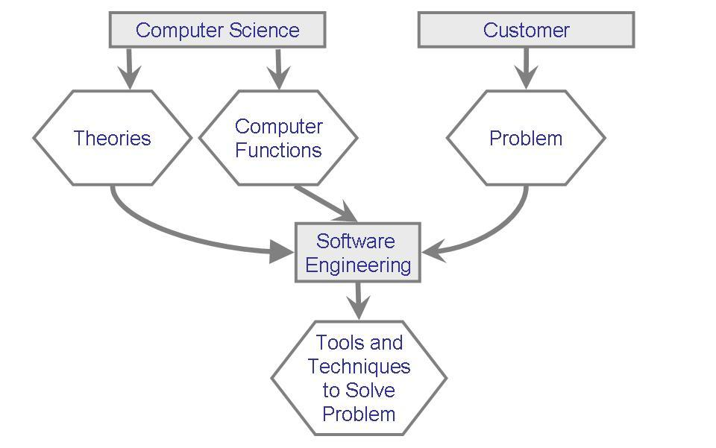
Solving Problems (continued)
Relationship between computer science and software engineering

Slide 31
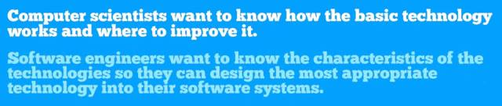
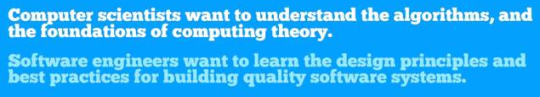

Slide 32
Costs Associated with SE
Development Costs
Running Costs

Slide 33
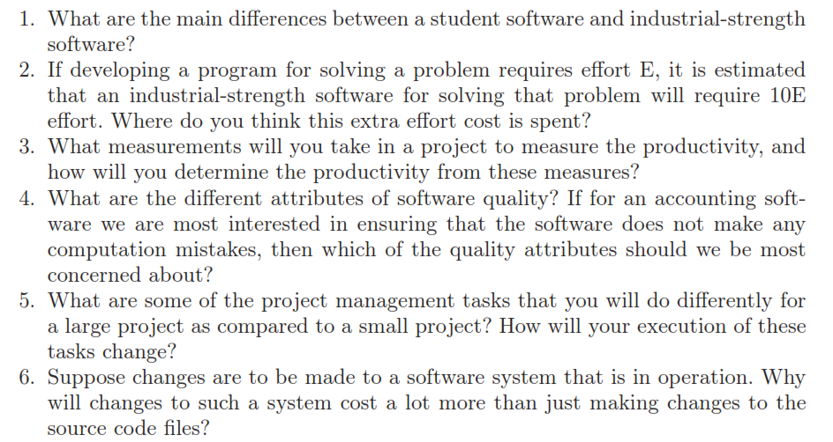

Slide 34
Special THANK FOR THE MATERIALS
Mr. Haroon Abdul Waheed
Mr. Sajid Saleem
Prof. Zeeshan Ali Rana
Pfleeger’s Book slides from UCF
Software Fundamentals

